Slide 1




Slide 2
Sampling Methods

Slide 3
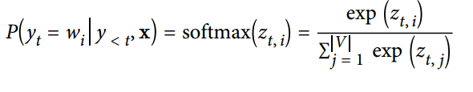
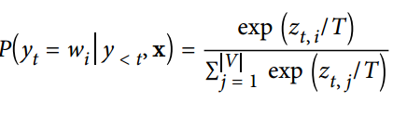
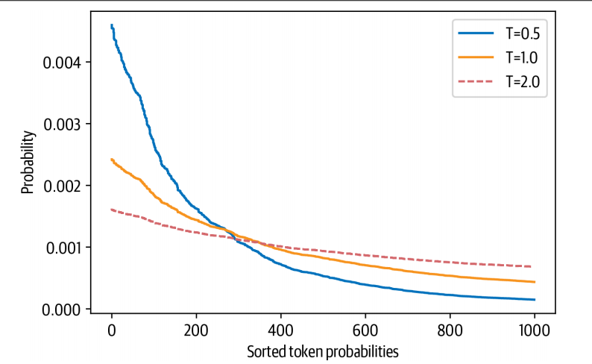
Temperature sampling
Temperature sampling: the simplest sampling method.
Randomly sample from the probability distribution of the model’s outputs over the full vocabulary at each timestep.
V the cardinality of the vocabulary: can easily control the diversity of the output
Adding a temperature (T)that rescales the logits before taking the SoftMax:
Higher temperatures > 1:
increase randomness.
The distribution flattens out.
Each token becomes equally likely.
Lower temperatures < 1:
make the output more focused and deterministic.
The distribution becomes peaked around the origin.
The rare tokens are suppressed.

Slide 4
Temperature sampling
High temperature effect on the output:
output_temp = model.generate(input_ids,
max_length=max_length,
do_sample=True,
temperature=2.0, top_k=0)
print(tokenizer. decode(output_temp[0]))
In a shocking finding, scientist discovered a herd of unicorns living in a remote, previously unexplored valley, in the Andes Mountains. Even more surprising to the researchers was the fact that the unicorns spoke perfect English.
IC!! Aura fast cutting picking iterations MG pept Rookie Wolverine penetrationyears ShowValuecrojosen Hardcore ca AC 02 dimensions Upload Frame Capture commonlychargolo Gearhunterspecial heroes 28184 hot4000 expert 2005 19802 cowboy 300 Troll nail gonetxt Heat buds rodoid dunk2011 ITS minedTurnBugch later compressed! Sebastmobi Issue epic powder insurrection Vand resurrected Cannabis degrees Peterluentbott pausesConsumer choking IM Posted say

Slide 5
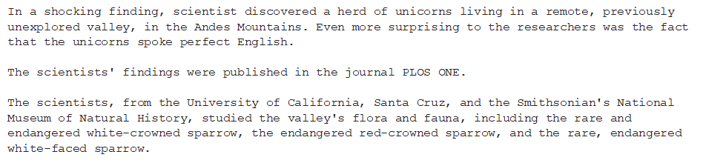
Temperature sampling
Low temperature effect on the output:
output_temp = model.generate(input_ids,
max_length=max_length,
do_sample=True,
temperature=0.5,
top_k=0)
print(tokenizer.decode(output_temp[0]))

Slide 6
The trade-off between coherence and diversity
Temperature is that it allows us to control the quality of the samples.
There is a trade-off between coherence (low temperature) and diversity (high temperature) that one has to tune to the use case at hand.
Truncate the distribution of the vocabulary.
This allows us to adjust the diversity freely with the temperature
Limited range that excludes words that would be too strange in the context (i.e., low-probability words)
Handled with top-k and nucleus (or top-p) sampling

Slide 7
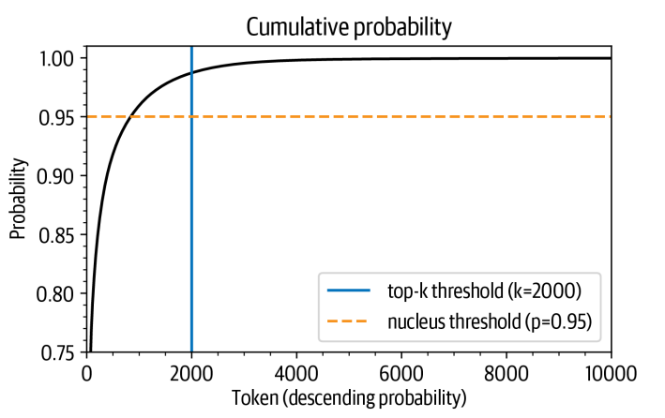

Top-k and Nucleus Sampling
Top-k sampling is a simple but effective sampling method.
It works by only considering the top-k most probable tokens at each time step.
The decoder is less likely to generate repetitive or nonsensical text.
The idea behind top-k sampling:
Avoid the low-probability choices by only sampling from the k tokens with the highest probability.
This puts a fixed cut on the long tail of the distribution and ensures that we only sample from likely choices.
There is roughly a 96% chance of picking any of the 1,000 tokens with the highest probability.
The probability rises quickly above 90% but saturates to close to 100% only after several thousand tokens.
There is a 1 in 100 chance of not picking any of the tokens that are not even in the top 2,000.

Slide 8
Top-k Sampling
Activate top-k sampling:
output_topk = model.generate(input_ids,
max_length=max_length,
do_sample=True,
top_k=50)
print(tokenizer.decode(output_topk[0]))
In a shocking finding, scientist discovered a herd of unicorns living in a remote, previously unexplored valley, in the Andes Mountains. Even more surprising to the researchers was the fact that the unicorns spoke perfect English.
According to news reports, researchers from Mexico have discovered a group of genetically engineered, non-hormonally-active unicorns living in a valley in the Andes Mountains of south central Mexico.
The researchers were looking for evidence of a prehistoric population of the creature which, in fact, existed at least 1,000 years ago. It is an unusual situation, because the animals are apparently so

Slide 9
How to choose top-k?
The value of k is chosen manually.
Looking at some text quality metrics: bleu or rouge metrics.
An alternative is to use a dynamic cutoff (nucleus or top-p) sampling:
This condition is when a certain probability mass in the selection is reached.

Slide 10
Top-k and Nucleus Sampling
Activate top-p sampling:
output_topp = model. generate(input_ids,
max_length=max_length,
do_sample=True,
top_p=0.90)
print(tokenizer. decode(output_topp[0]))
In a shocking finding, scientist discovered a herd of unicorns living in a remote, previously unexplored valley, in the Andes Mountains. Even more surprising to the researchers was the fact that the unicorns spoke perfect English.
An expert on the creatures told the press that the strange creatures were extremely close to extinction, but had been saved thanks to human intervention. A "unicorn" was spotted in the hills of Bolivia and the researchers decided to go visit the site, which had been hidden for the last 20 years.
In August of 2001, a group of explorers from the Bolivian Academy of Sciences traveled to

Slide 11
Combine the two sampling methods
output_topp = model.generate(input_ids,
max_length=max_length,
do_sample=True,
top_k = 50,
top_p=0.90)
print(tokenizer. decode(output_topp[0]))
In a shocking finding, scientist discovered a herd of unicorns living in a remote, previously unexplored valley, in the Andes Mountains. Even more surprising to the researchers was the fact that the unicorns spoke perfect English.
The unicorns were found in the Andean Cordillera National Park in Colombia. According to Dr. José Luis Abajada, a biologist from the National University of Colombia, one of the unicorn herds living in the area was able to communicate in the language of their wild ancestors. "We have never seen wild animals speak this way before, and it's the first time in the scientific world,

Slide 12
Which Decoding Method Is Best?
Unfortunately, there is no universally “best” decoding method. Which approach is best will depend on the nature of the task you are generating text for.
If you want your model to perform a precise task like arithmetic or providing an answer to a specific question:
You should lower the temperature or use deterministic methods like greedy search in combination with beam search to guarantee getting the most likely answer.
If you want the model to generate longer texts and even be a bit creative:
You should switch to sampling methods and increase the temperature or use a mix of top-k and nucleus sampling.

Slide 13
Final thoughts
Generating text requires at least one forward pass per generated token
Beam search: makes text generation computationally demanding, and one needs the right infrastructure to run a text generation model at scale.
A good decoding strategy that transforms the model’s output probabilities into discrete tokens can improve the text quality.
Finding the best decoding strategy requires some experimentation and a subjective evaluation of the generated texts.
In NLP tasks:
Choose a model performance metric that reflects the problem we want to solve.

Slide 14


